Slide 1

Accessibility & internationalization
Wenxuan Shi
College of Software, Nankai University
Email: shiwx@nankai.edu.cn
Wechat: 13920561100

Slide 2
Topics
Accessibility
Internationalization

Slide 3
Accessibility
Notes:
StatelessWidget is used for immutable elements that only rely on the object configuration information
StatefulWidget is used for elements that can dynamically change based on state-changes in the system
Everytime that state changes, setChange() is called by the object

Slide 4
Introduction
Flutter is committed to supporting developers who want to make their apps more accessible: usable by as many people as possible, including those with disabilities such as blindness or motor impairment.
Flutter supports three components for accessibility support:
Large fonts: Render text widgets with user-specified font sizes
Screen readers: Communicate spoken feedback about UI contents
Sufficient contrast: Render widgets with colors that have sufficient contrast

Slide 5
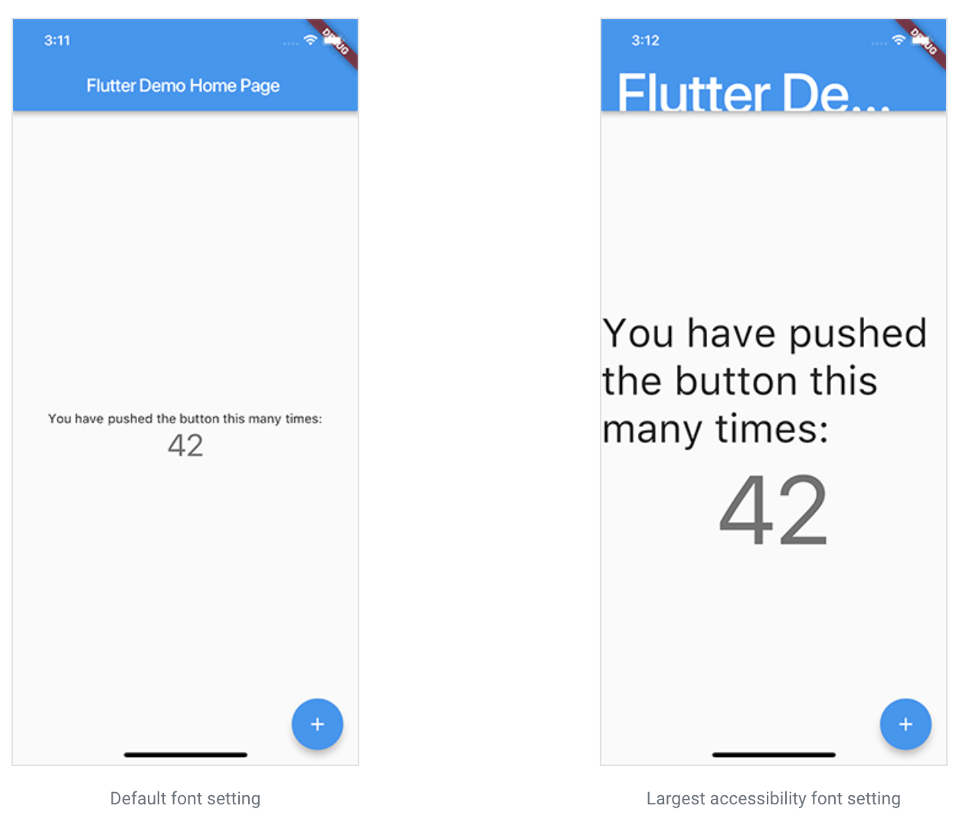
Large fonts

Slide 6
Screen readers
For mobile, screen readers (TalkBack, VoiceOver) enable visually impaired users to get spoken feedback about the contents of the screen and interact with the UI via gestures on mobile and keyboard shortcuts on desktop.

Slide 7
Screen readers
For web, the following screen readers are currently supported:
Mobile Browsers:
iOS - VoiceOver
Android - TalkBack
Desktop Browsers:
MacOS - VoiceOver
Windows - JAWs & NVDA

Slide 8
Sufficient contrast
Sufficient color contrast makes text and images easier to read.
The W3C recommends:
At least 4.5:1 for small text (below 18 point regular or 14 point bold)
At least 3.0:1 for large text (18 point and above regular or 14 point and above bold)

Slide 9
Accessibility release checklist
Active interactions. Ensure that all active interactions do something.
Screen reader testing. Test your app with TalkBack (Android) and VoiceOver (iOS).
Contrast ratios. We encourage you to have a contrast ratio of at least 4.5:1 between controls or text and the background, with the exception of disabled components.
Context switching. Nothing should change the user’s context automatically while typing in information.

Slide 10
Accessibility release checklist
Tappable targets. All tappable targets should be at least 48x48 pixels.
Errors. Important actions should be able to be undone.
Color vision deficiency testing. Controls should be usable and legible in colorblind and grayscale modes.
Scale factors. The UI should remain legible and usable at very large scale factors for text size and display scaling.

Slide 11
Internationalization
Notes:
StatelessWidget is used for immutable elements that only rely on the object configuration information
StatefulWidget is used for elements that can dynamically change based on state-changes in the system
Everytime that state changes, setChange() is called by the object

Slide 12
What you’ll learn
How to track the device’s locale (the user’s preferred language).
How to manage locale-specific app values.
How to define the locales an app supports.

Slide 13
Sample internationalized apps
If you’d like to start out by reading the code for an internationalized Flutter app, here are two small examples. The first one is intended to be as simple as possible, and the second one uses the APIs and tools provided by the intl package.
Minimal internationalization
Internationalization based on the intl package

Slide 14
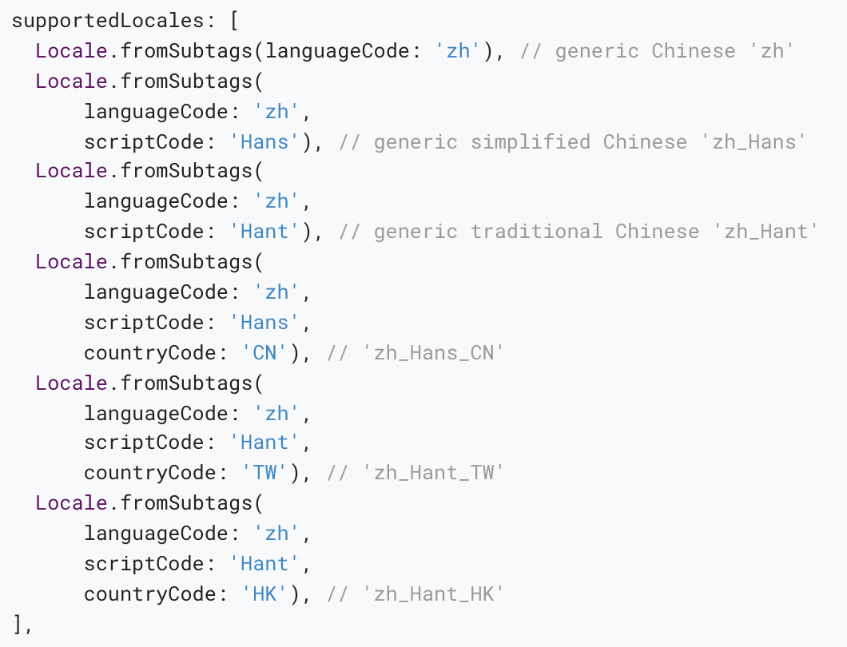
Advanced locale definition
Example: In order to fully express every variant of Chinese for the country codes CN, TW, and HK, the list of supported locales should include:

Slide 15
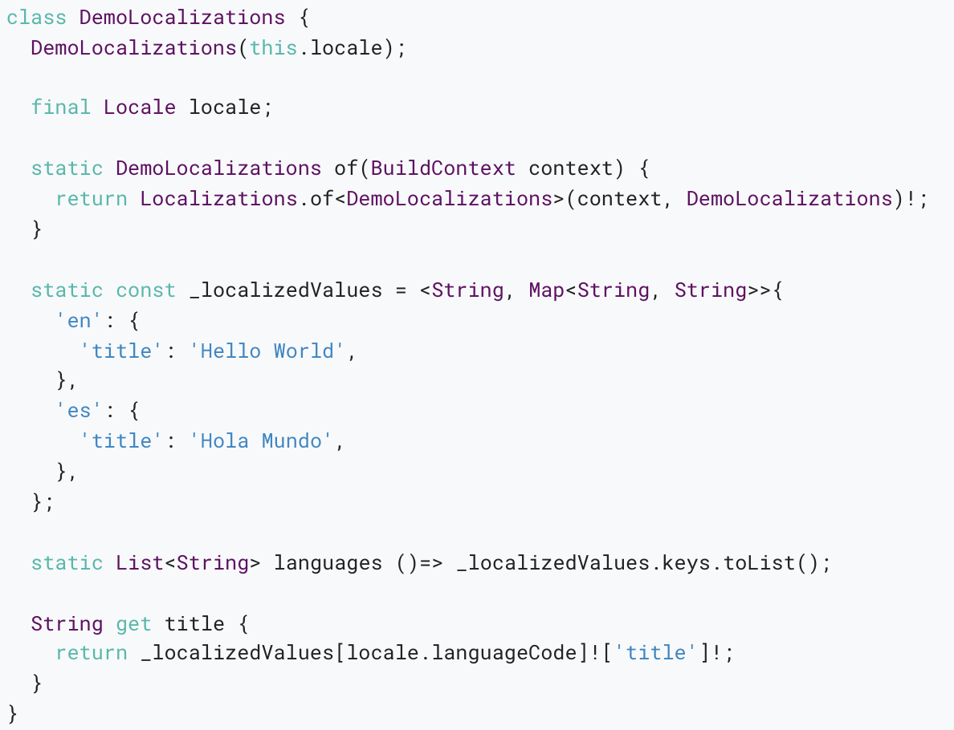
Alternative internationalization workflows
An alternative class for the app’s localized resources

Slide 16
Thank you!
Wenxuan Shi
College of Software, Nankai University
Email: shiwx@nankai.edu.cn
Wechat: 13920561100

